Slide 1








Lesson 1. HTML Attribute vs DOM Property

Slide 2
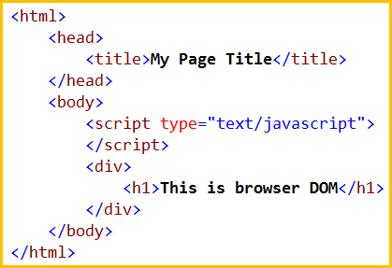
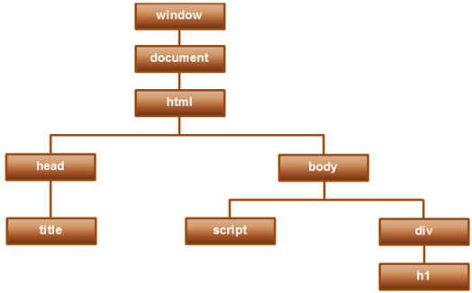
HTML Attribute vs DOM Property
DOM stands for Document Object Model. When a browser loads a web page, the browser creates a Document Object Model of that page
DOM contains the HTML elements as objects, their properties, methods and events and it is a standard for accessing, modifying, adding or deleting HTML elements

Slide 3

HTML Attribute vs DOM Property
HTML Element Attribute v/s DOM Property
Attributes are defined by HTML, where as properties are defined by the DOM
Attributes initialize DOM properties. Once the initialization complete, the attributes job is done
Property values can change, where as attribute value can't
Important Points
HTML attributes and the DOM properties are different things
Angular binding works with properties and events, and not attributes
disabled is DOM property, and not attribute

Slide 4
Q & A
Contact:rashmipawaskar@synergetics-india.com

Slide 5
Thank You

